Slide 1
Why You Should -Be Using Pester!

Slide 2

Intro
Senior Systems Engineer for an Insurance Company 🤑
twitter.com/jwmoss 👀
github.com/jwmoss 💻
Using Powershell for 2 years 💙
Live outside Raleigh, North Carolina 🚜
Published in a book about a tweet I posted in 2011 about Steve Jobs 🤓

Slide 3


Slide 4
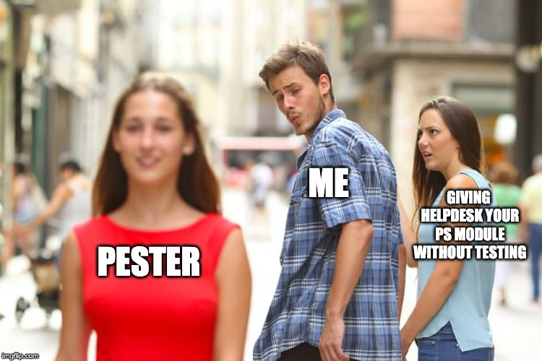

Slide 5
What is Pester?
A testing framework written in Powershell
Unit tests: test a piece (unit) of your code, don’t touch external system.
Integration tests: reach out to external system and tests your code.
A way to check the thing you’re doing in Powershell is actually the thing you meant to do in Powershell.
Forces you to re-think how you write Powershell.
Runs on Linux, macOS, or Windows.
Comes pre-installed with Windows 10 and Windows Server 2016.
Microsoft wants you to use this tool, read the PDF - https://docs.microsoft.com/en-us/powershell/dsc/further-reading/whitepapers
WARNING: This presentation may turn you more into a developer than you thought was possible.

Slide 6
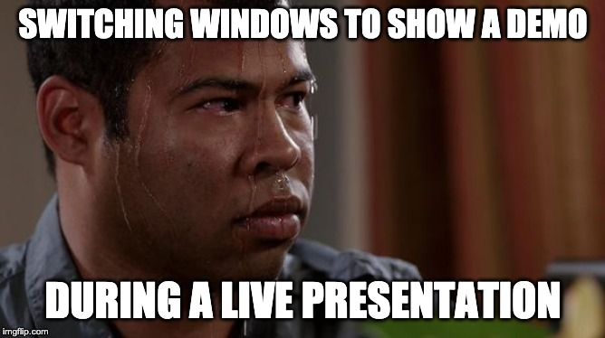
Demo!

Slide 7
Pester Use-Case 1
On-boarding New Users:
AD Account exists
UPN matches email address
UPN matches sip address
Company, Department, EmployeeID, Title, City, Office, State, and Home Drive is not empty
Verify common AD Group memberships are set
Azure AD Group-Based licensing + firewall access
Location-based AD Groups are set
O365 licensing is set.

Slide 8
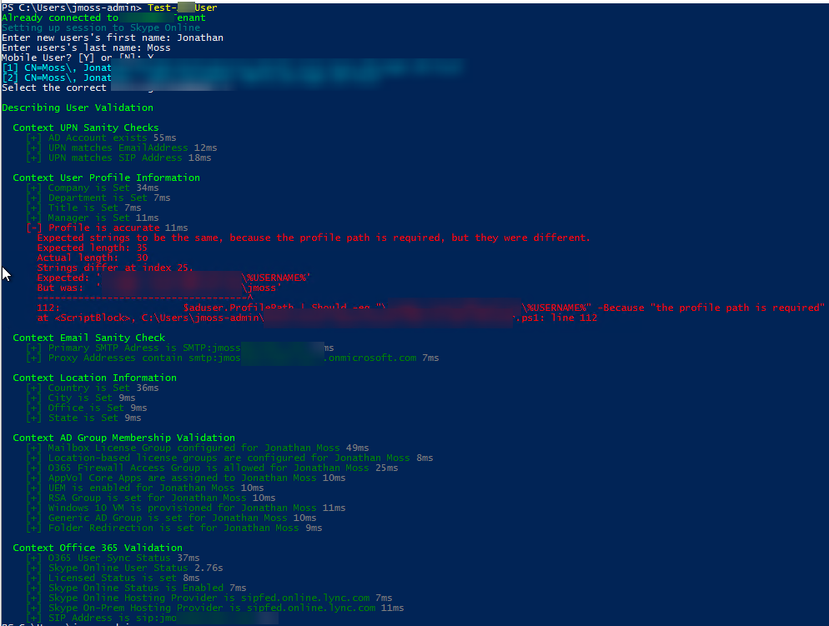

Slide 9
Pester Use-Case 2
Creating new Servers:
AD Description is set
Exists in DNS
In the correct OU
Correct network based on pre-defined rules
Validate vCenter portgroup
Validate it’s running/turned on
Validate base software installed (AV, Solarwinds, etc).

Slide 10
Other Uses of Pester
PSKoans - https://github.com/vexx32/PSKoans COMING SOON TO A USERGROUP NEAR YOU! 🤓
DBAchecks (SQL Server Validation) - https://github.com/sqlcollaborative/dbachecks
Operation-Validation-Framework (Infrastructure Validation) - https://github.com/PowerShell/Operation-Validation-Framework
Vester (Validate vSphere Configuration) - https://github.com/WahlNetwork/Vester

Slide 11
More Uses of Pester
Validating Active Directory Attributes - https://mattmcnabb.github.io/pester-lob
Validating DNS Records - https://pshirwin.wordpress.com/2015/11/06/pester-script-to-test-dns-configuration/
Skype/Lync Infrastructure Validation - https://sysnetdevops.com/2017/06/05/testing-infrastructure-with-pester/
Domain Controller Validation - https://github.com/EvotecIT/PesterInfrastructureTests
Citrix/XenApp Validation - http://citrixlab.dk/archives/812
Software deployment readiness check - https://github.com/MathieuBuisson/DeploymentReadinessChecker

Slide 12
Credit where Credit’s Due
Mark Wragg (https://github.com/markwragg | @markwragg)
Jakob Jares, one of the main developers of Pester (http://jakubjares.com/ | @nohwnd)
Reddit https://www.reddit.com/r/PowerShell/search?q=Pester&restrict_sr=1&sort=top
Pester Wiki - https://github.com/pester/Pester/wiki
DBAChecks PS Module - https://github.com/sqlcollaborative/dbachecks
The first 10 pages of Google Results for “Powershell Pester”
The Pester Book by Adam Bertram (https://leanpub.com/pesterbook)

Slide 13
“I really wish there was a way to test or validate my Powershell code.”
–Said No One Ever (Hopefully after this talk)

Slide 14
Questions?

